Slide 1




ART REBIRTH
GALLERY🎨
Presented by: Yi Hao

Slide 2
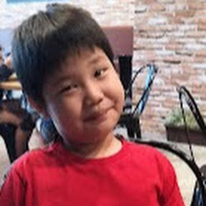
GROUP MEMBER
Yi Hao (solo)

Slide 3
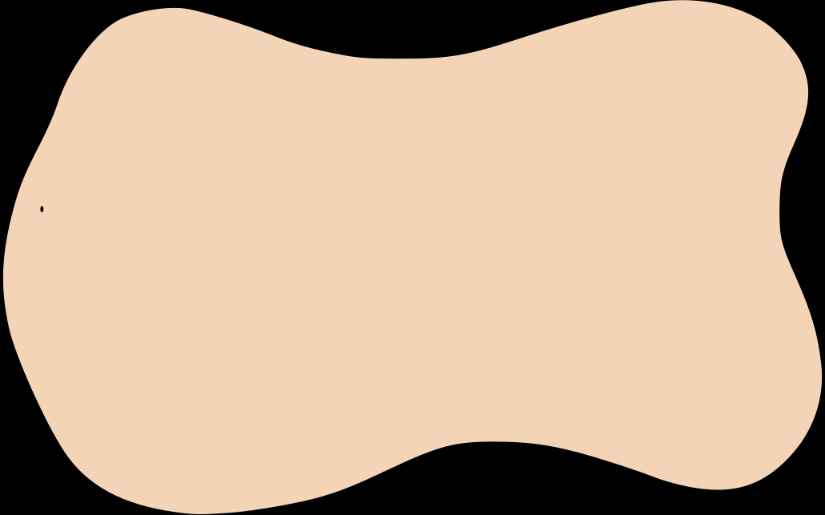
PROJECT PURPOSE
To exhibit classic art, fashion, and culture transformed with modern or futuristic elements — blending history and technology.
Visitors can learn how art evolves over time and get inspired to explore digital creativity or cultural fusion.
It highlights how traditional ideas can be revived and reinterpreted using digital art, AI, neon styles, cyber aesthetics, etc.

Slide 4
📚STORY/INSPIRATION
Art Rebirth Gallery was inspired by a love for both classical art and futuristic imagination. The goal was to create a unique website where old masterpieces are reimagined with modern technology — like the Mona Lisa with AR glasses or Van Gogh’s Starry Night reacting to live weather. This project not only showcases creativity, but also allowed us to explore web design skills through animations, scroll effects, and interactive layouts.

Slide 5


🎯 TARGET AUDIENCE
Art lovers interested in classical and modern mashups
Students and educators exploring art history with a digital twist
Digital artists and designers looking for futuristic inspiration
Museum and gallery fans who enjoy interactive and creative exhibits
General public curious about how technology transforms traditional art

Slide 6
PROGRAMMING LANGUAGES USED
Boootstrap– A responsive front-end framework used to:
Simplify layout with a grid system
Add components like navbar, buttons, and responsive columns
Ensure the website looks good on all devices (mobile, tablet, desktop)
HTML – for the structure and content of the website
CSS – for styling, layout, and animations
JavaScript – for interactive effects and scroll-based animations
Font Awesome – for icons (e.g., Facebook, Twitter)

Slide 7
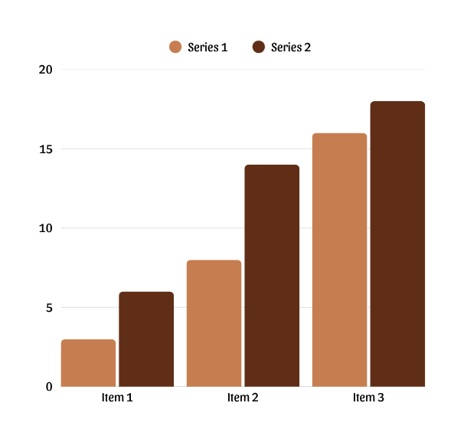
🔑KEY FEATURES
Interactive Navigation Bar – Smooth scrolling and hamburger menu for mobile view
Spotlight Exhibit – Highlighted reimagined artwork with side-by-side description
Gallery Display – Featured artworks with titles and creative descriptions

Slide 8
🔧 ENHANCEMENTS
Added scroll-based animations for better user engagement
Integrated multiple animation styles (flip, blur, typewriter, etc.)
Improved responsiveness for mobile and tablet users
Organized layout using Bootstrap grid system
Enhanced visual appeal with custom fonts and colors

Slide 9
CONCLUSION
In conclusion, this project allowed me to explore web design using HTML, CSS, and Bootstrap. I learned how to create interactive layouts, apply styles, and improve user experience with animations and effects. Although I faced some challenges in responsiveness and effects, I successfully overcame them with research and practice. I hope to continue improving this website by adding more features and making it more dynamic.

Slide 10


THANK YOU!

